Slide 1
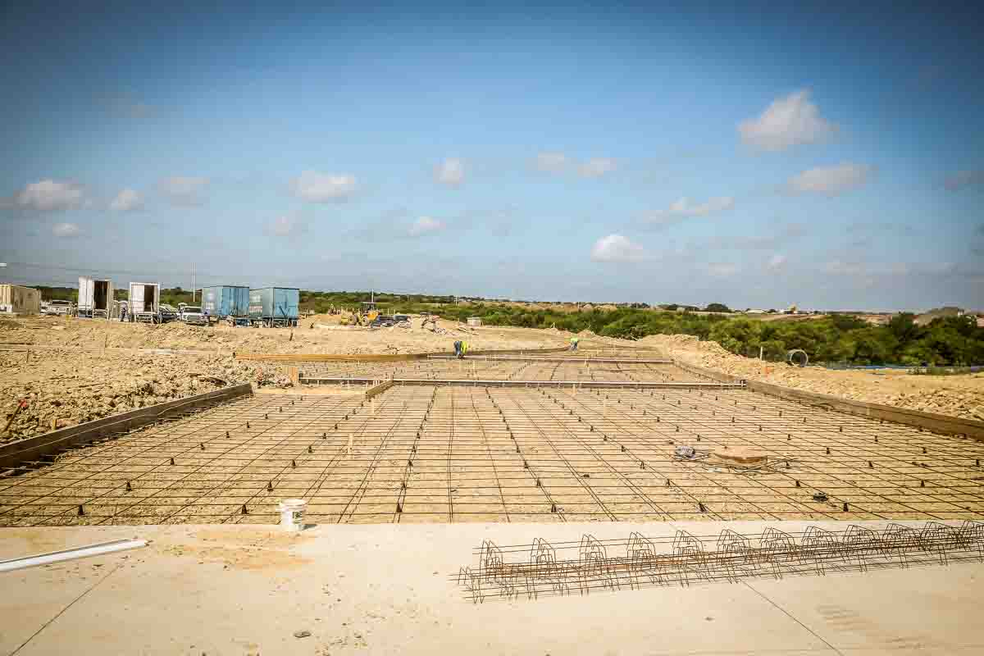
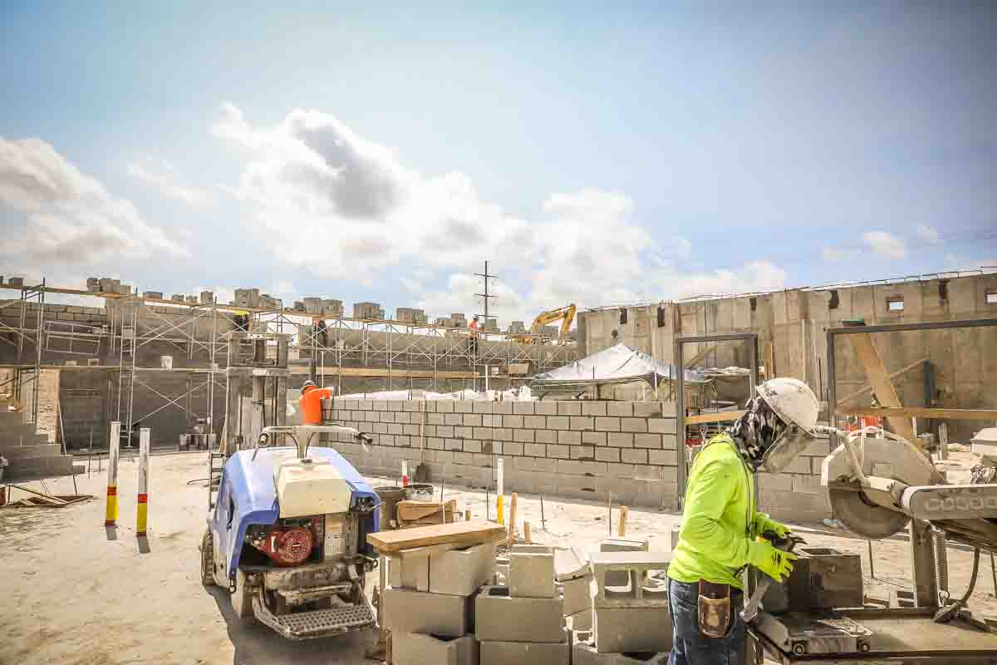
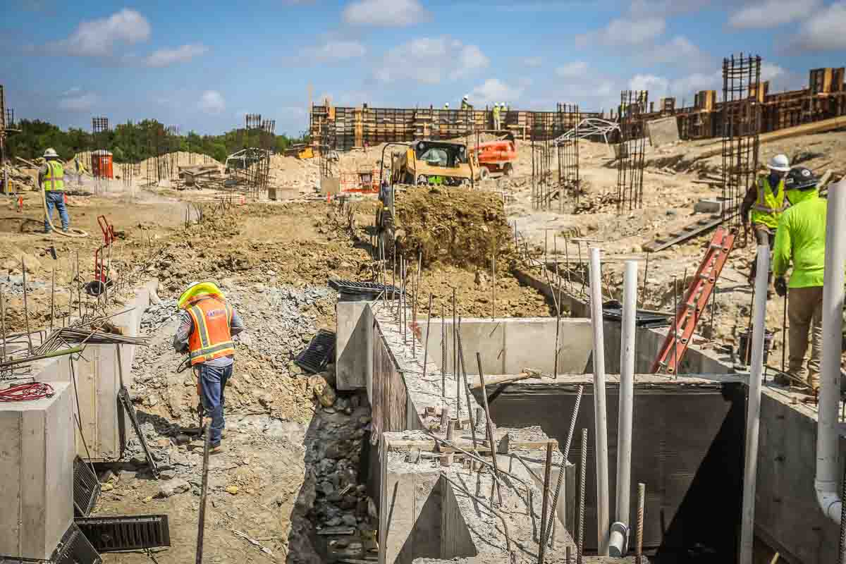
NEW ADMINISTRATION BUILDING
Rebar is in place to pour the main entrance to the building. CMU block is being utilized to form up the walls on the lower level.

Slide 2
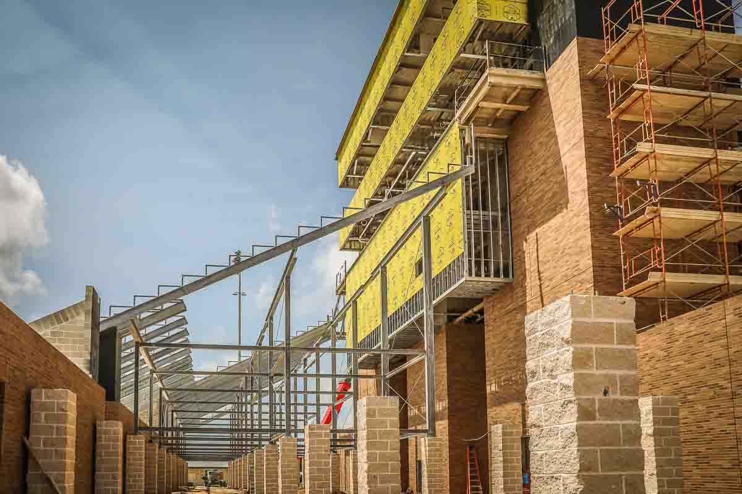
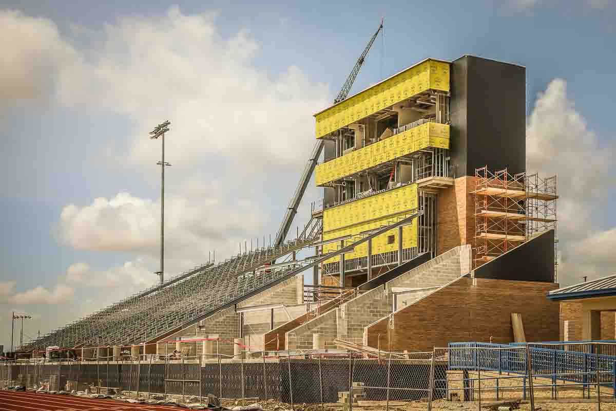
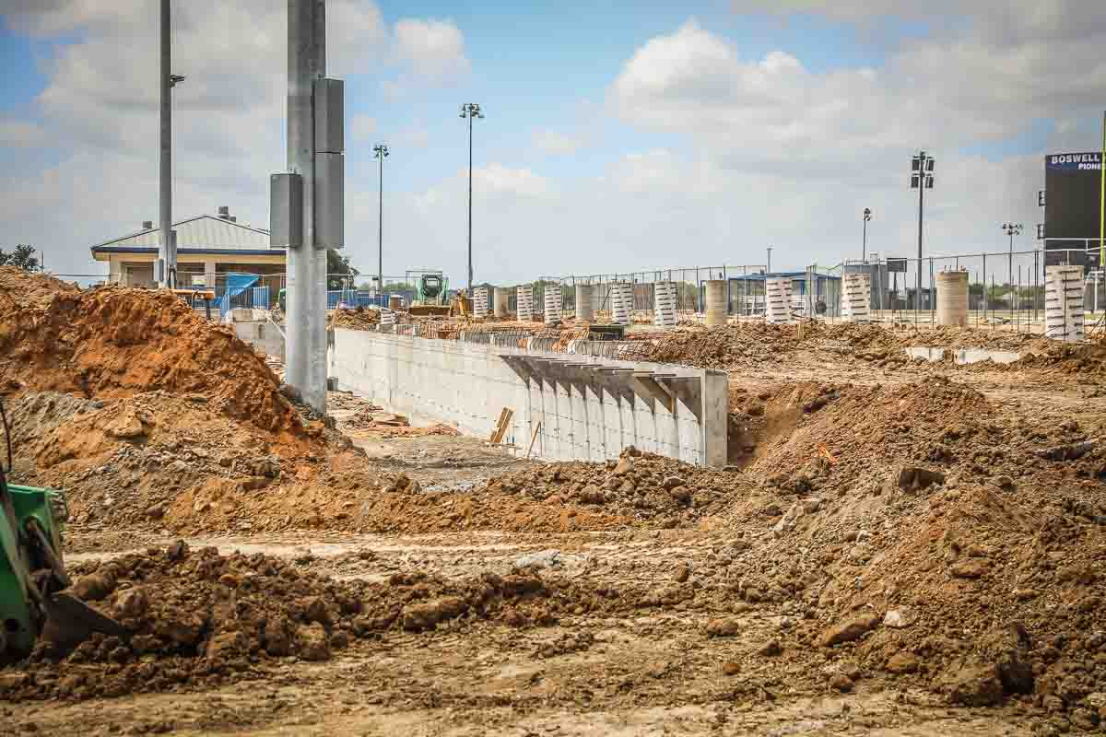
BOSWELL HS
Main grandstand structure is in progress. Workers continue to lay brick on the west, south, and north sides of the pressbox. Visitor’s bleachers main concourse retaining wall has been poured. Bleachers are scheduled to arrive on August 2. Construction, with good weather, should only take three weeks.

Slide 3
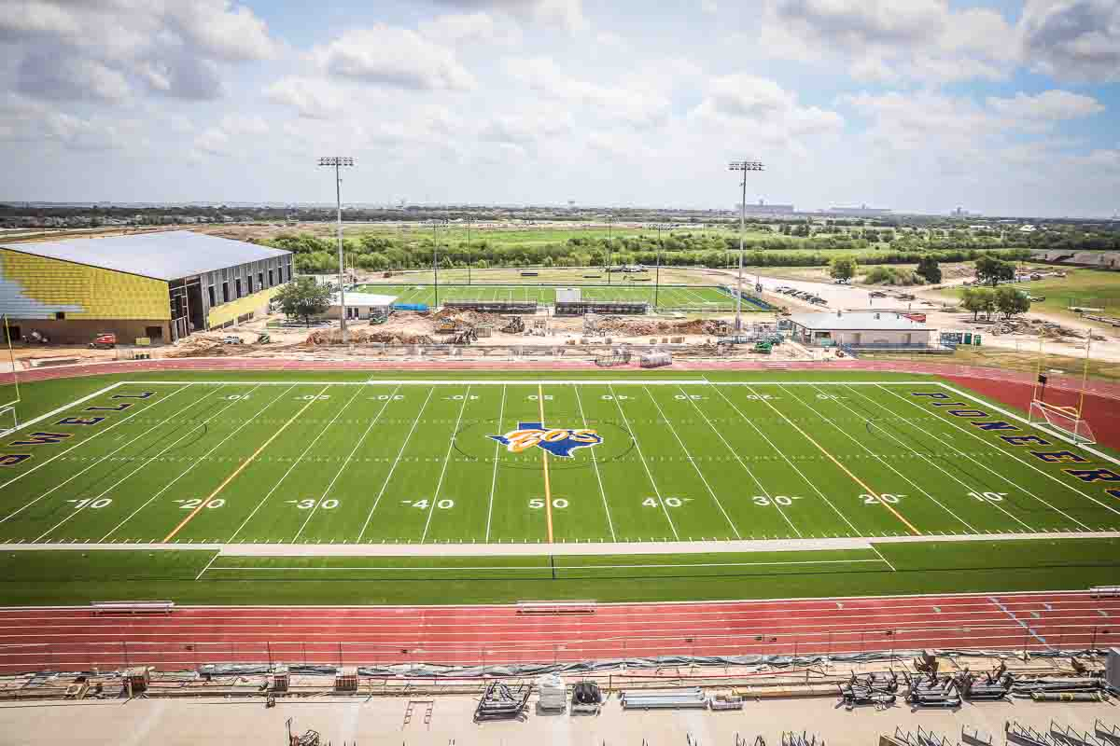
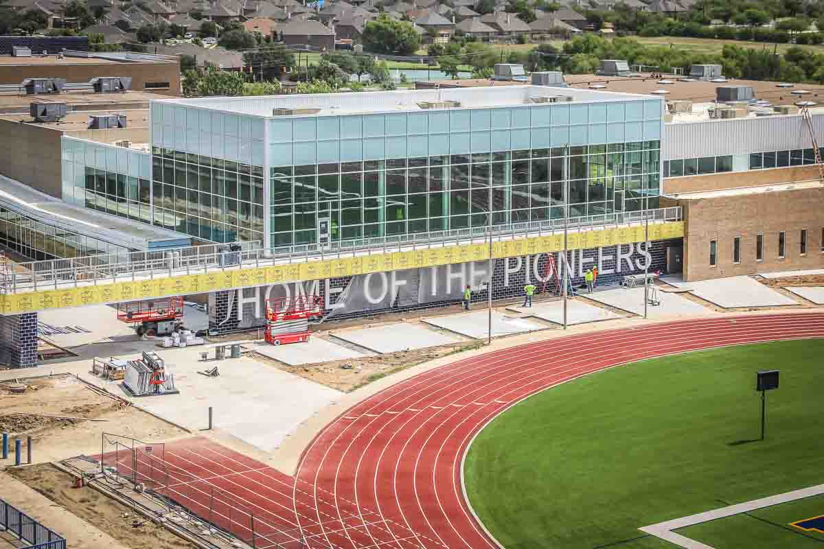
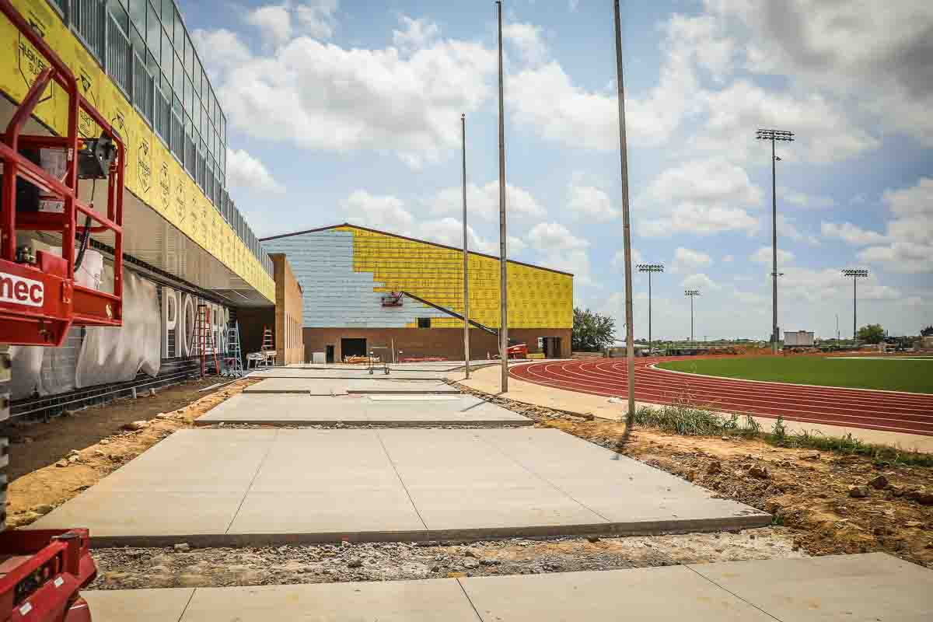
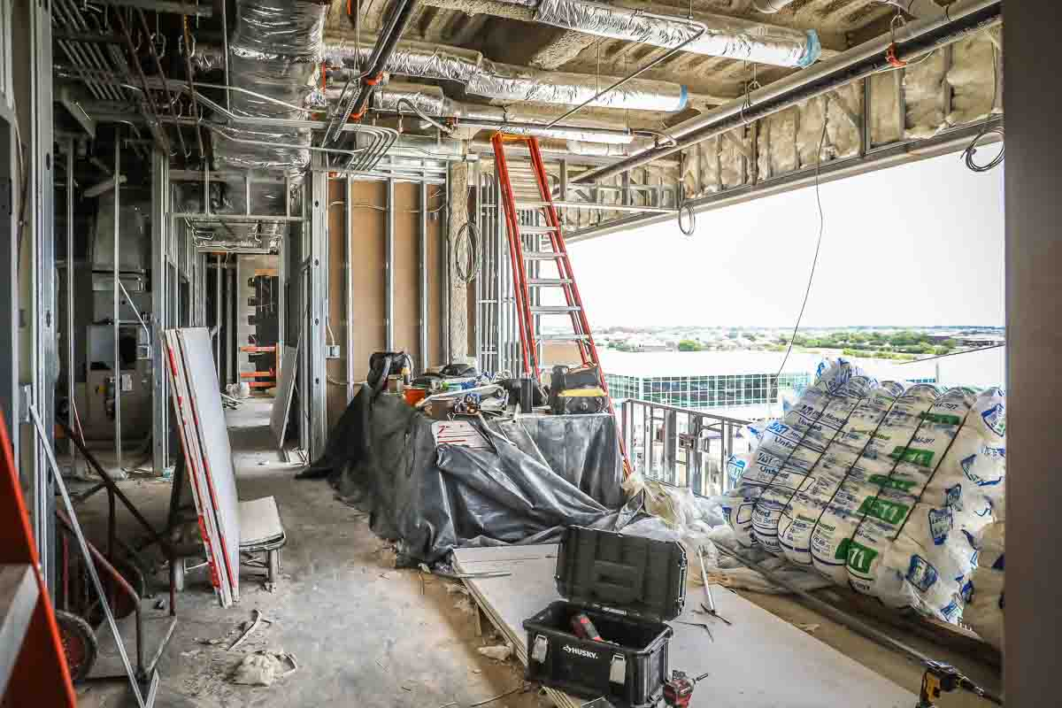
Views from the pressbox show the main field and new weight room area. Pressbox construction continues with rough-in electrical, insulation, and sheetrock.
Main walkway between the field and dressing rooms

Slide 4
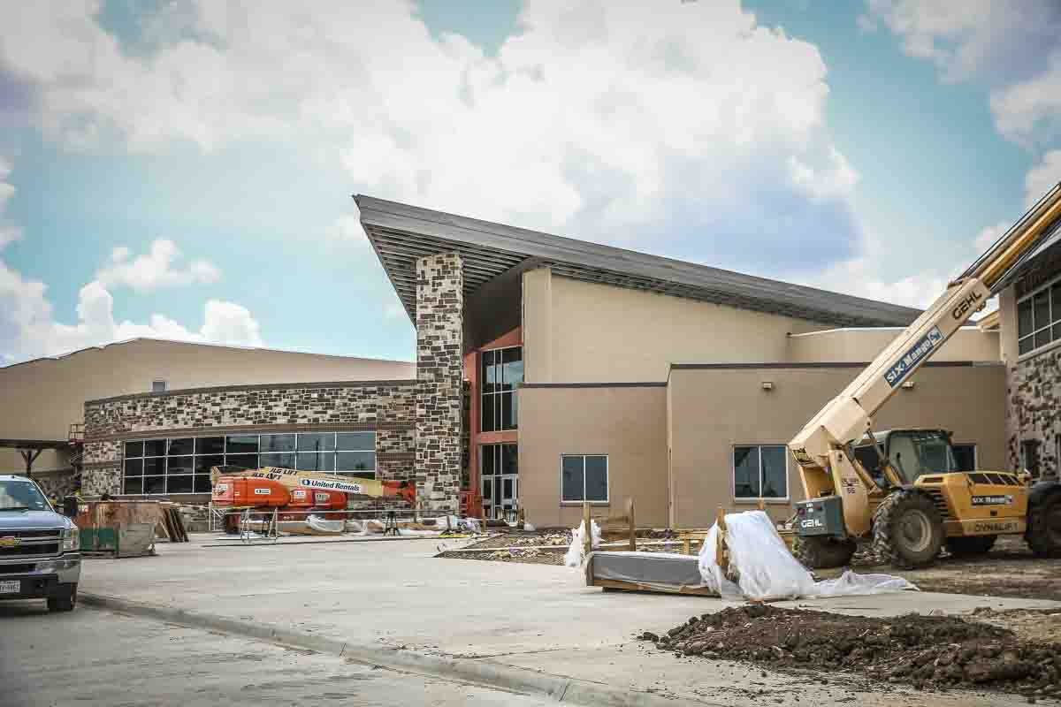
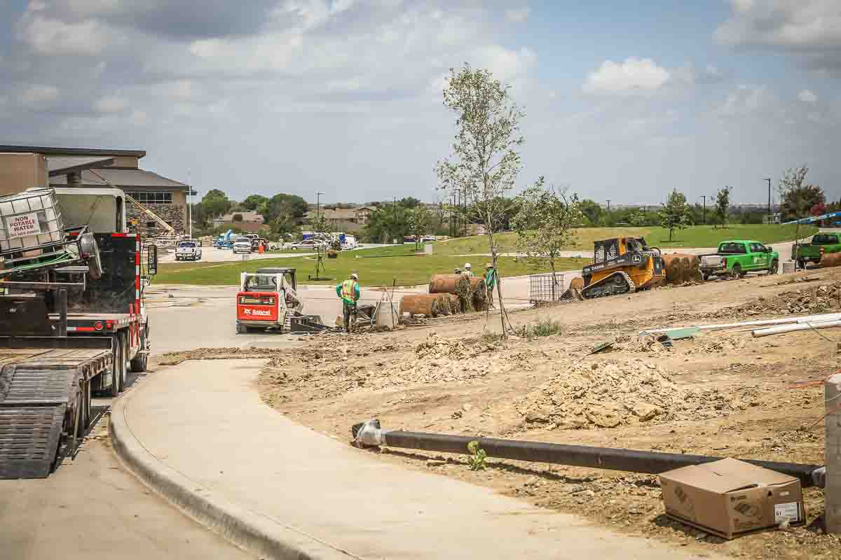
LAKE COUNTRY ES
Landscaping continues to progress, as does the rock and brick clean-up.

Slide 5
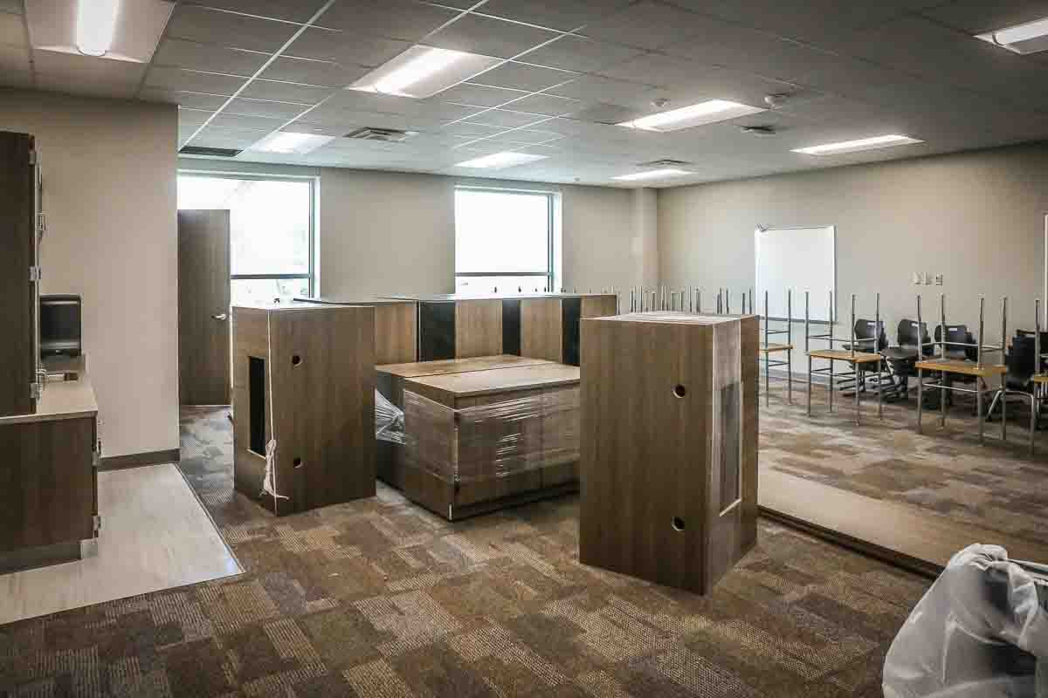
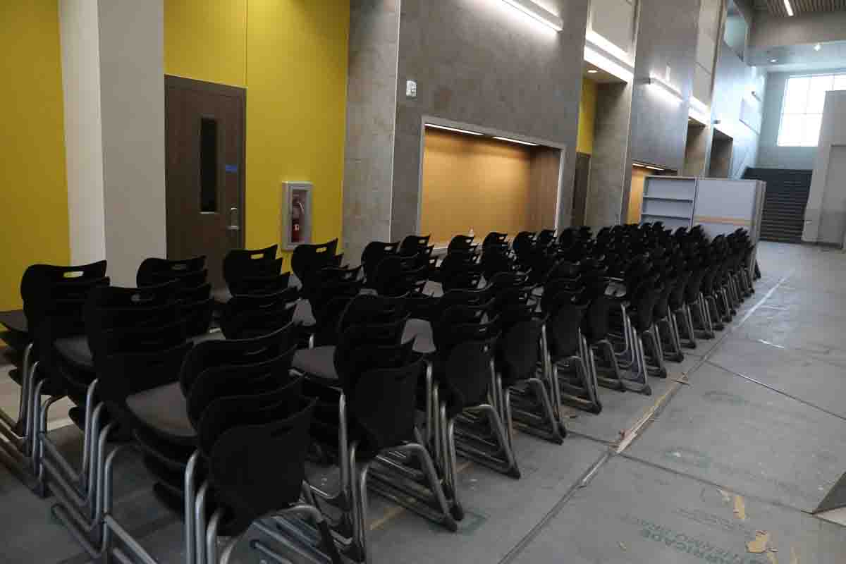
Furniture is on site, being delivered, and assembled as needed.

Slide 6
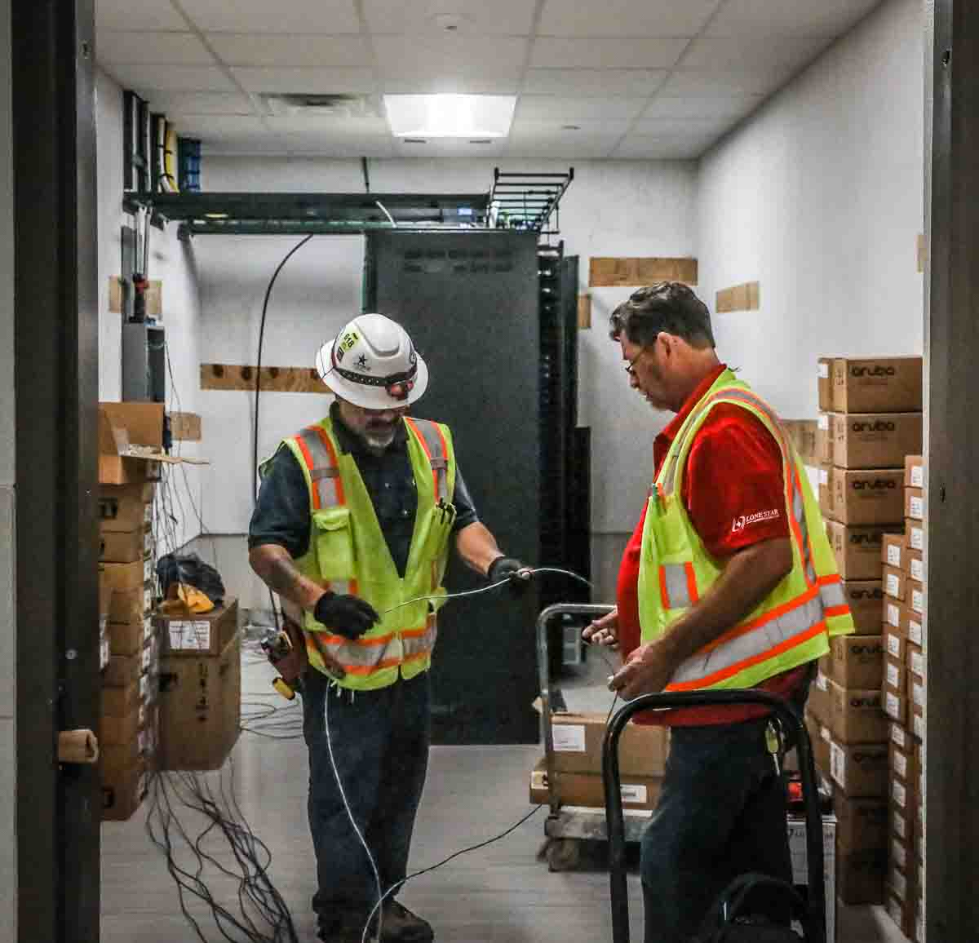
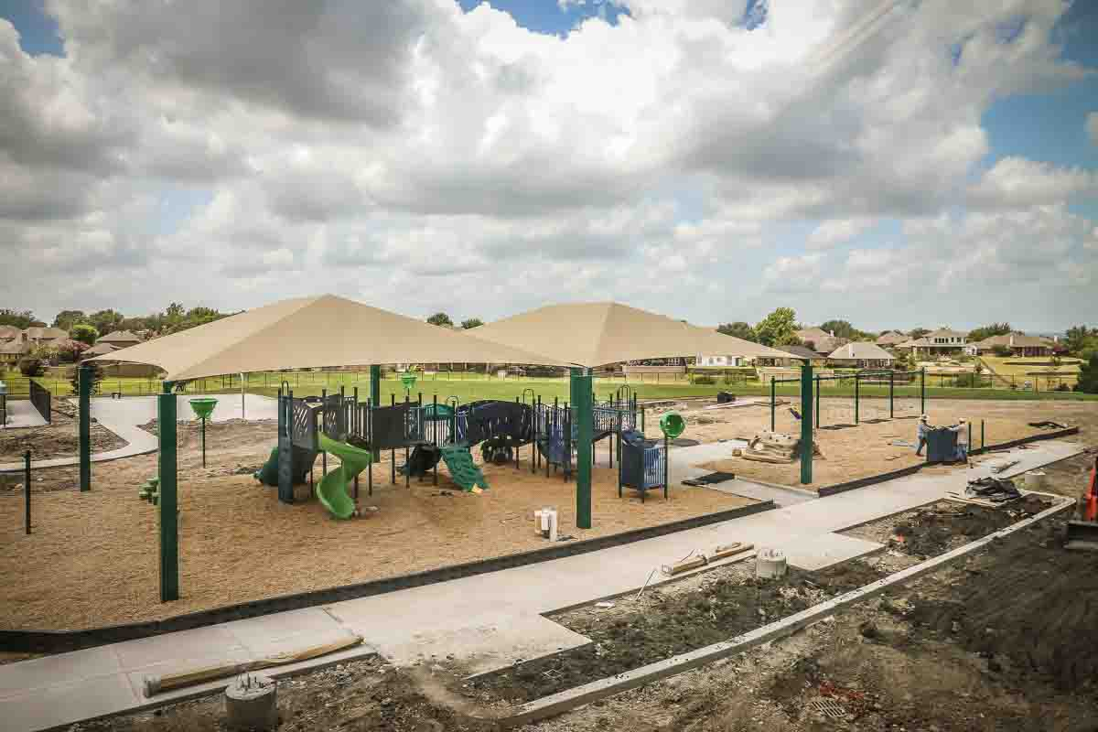
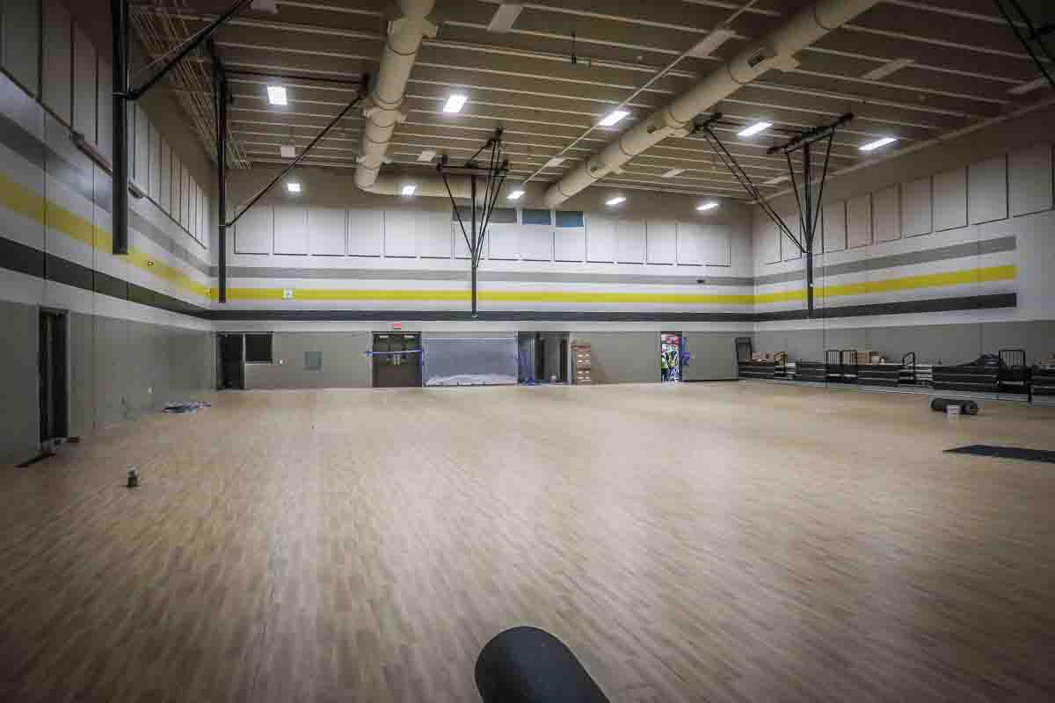
Gym floor has been installed along with the technology network. Playground area has been completed and is ready for school to begin.

Slide 7
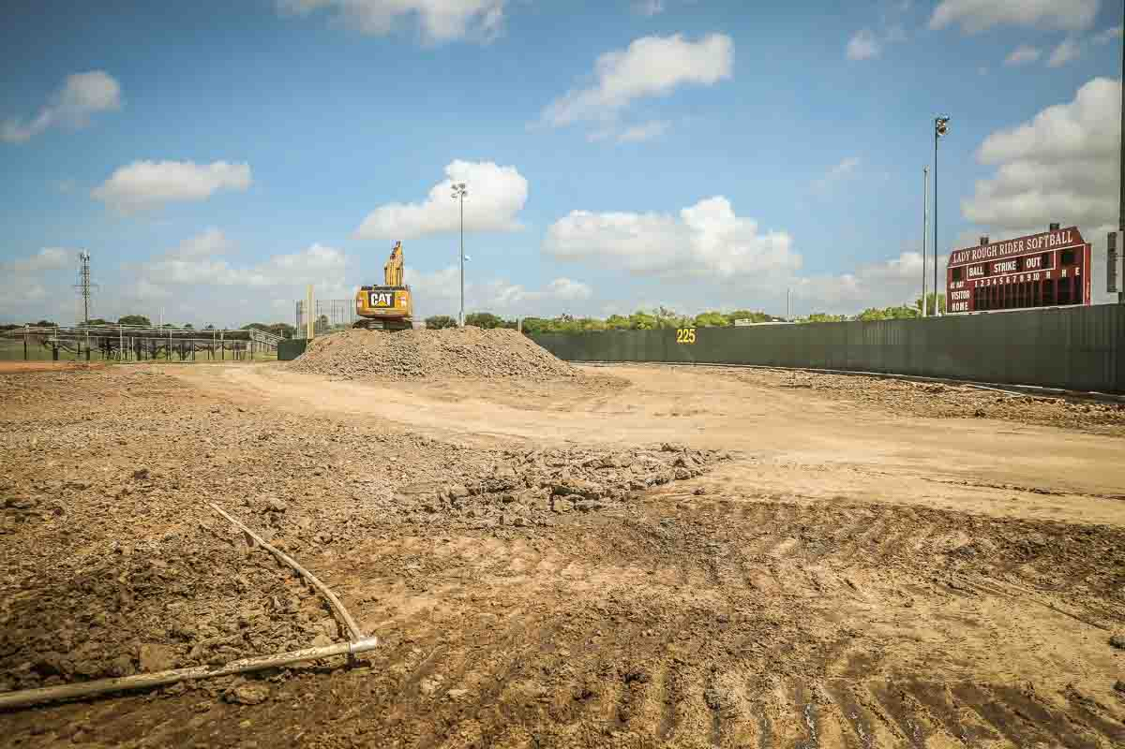
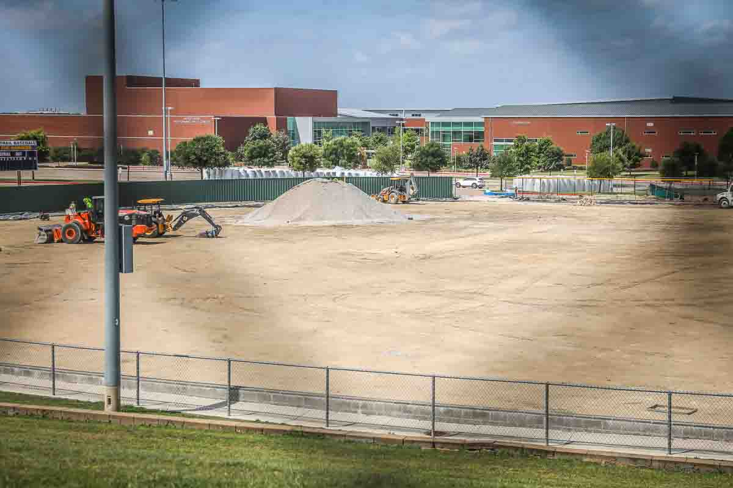
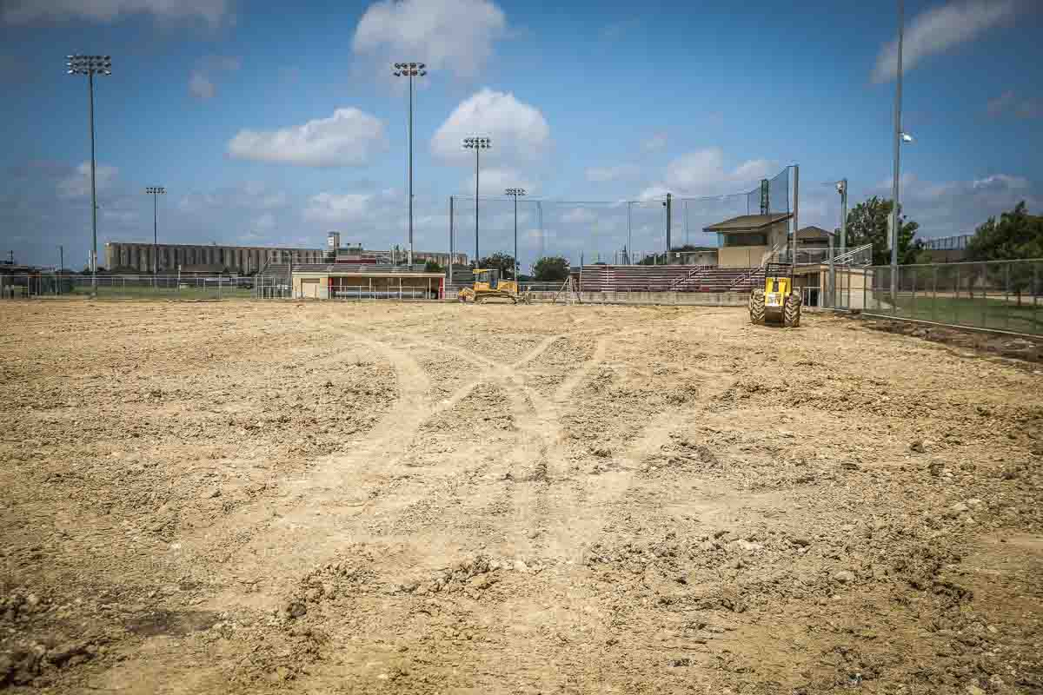
CHISHOLM TRAIL HS AND SAGINAW HS
Moisture conditioning and final grade is in progress in both baseball and softball fields.

